Slide 1

ML using Python Session 6
Nabajyoti Pathak

Slide 2
Agenda
Decision Tree
Random Forest

Slide 3
What is a Decision Tree ? How does it work ?
Decision tree is a type of supervised learning algorithm (having a pre-defined target variable) that is mostly used in classification problems.
It works for both categorical and continuous input and output variables.
In this technique, we split the population or sample into two or more homogeneous sets (or sub-populations) based on most significant splitter / differentiator in input variables.

Slide 4

Decision Tree

Slide 5
Example:-
Let’s say we have a sample of 30 students with three variables Gender (Boy/ Girl), Class( IX/ X) and Height (5 to 6 ft). 15 out of these 30 play cricket in leisure time.
Now, I want to create a model to predict who will play cricket during leisure period?
In this problem, we need to segregate students who play cricket in their leisure time based on highly significant input variable among all three.
This is where decision tree helps, it will segregate the students based on all values of three variable and identify the variable, which creates the best homogeneous sets of students (which are heterogeneous to each other). In the snapshot below, you can see that variable Gender is able to identify best homogeneous sets compared to the other two variables.

Slide 6
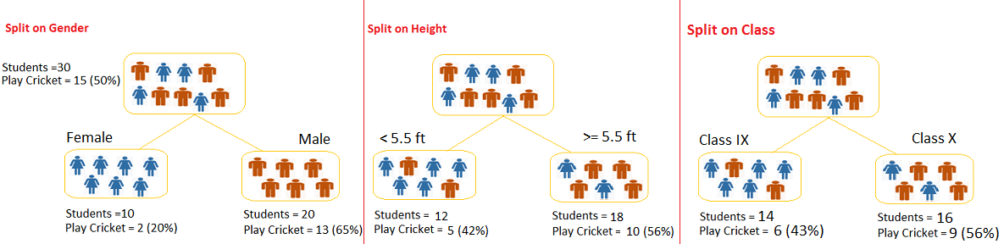

Slide 7
Thinking???
As mentioned above, decision tree identifies the most significant variable and it’s value that gives best homogeneous sets of population.
Now the question which arises is, how does it identify the variable and the split?
To do this, decision tree uses various algorithms, which we will shall discuss in the following section.

Slide 8
Types of Decision Trees
Categorical Variable Decision Tree: Decision Tree which has categorical target variable then it called as categorical variable decision tree. Example:- In above scenario of student problem, where the target variable was “Student will play cricket or not” i.e. YES or NO.
Continuous Variable Decision Tree: Decision Tree has continuous target variable then it is called as Continuous Variable Decision Tree.

Slide 9
Example
Let’s say we have a problem to predict whether a customer will pay his renewal premium with an insurance company (yes/ no).
Here we know that income of customer is a significant variable but insurance company does not have income details for all customers.
Now, as we know this is an important variable, then we can build a decision tree to predict customer income based on occupation, product and various other variables.
In this case, we are predicting values for continuous variable.

Slide 10
Important Terminology related to Decision Trees
Root Node:
Splitting:
Decision Node:
Leaf/ Terminal Node:
Pruning: When we remove sub-nodes of a decision node, this process is called pruning. You can say opposite process of splitting.
Branch / Sub-Tree:
Parent and Child Node:

Slide 11
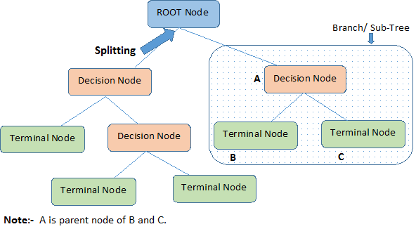

Slide 12
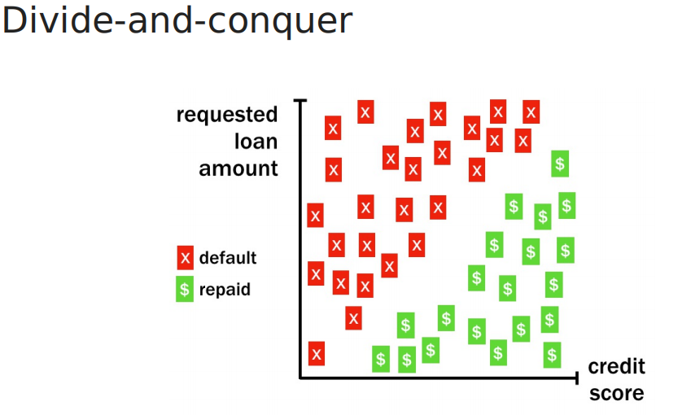

Slide 13
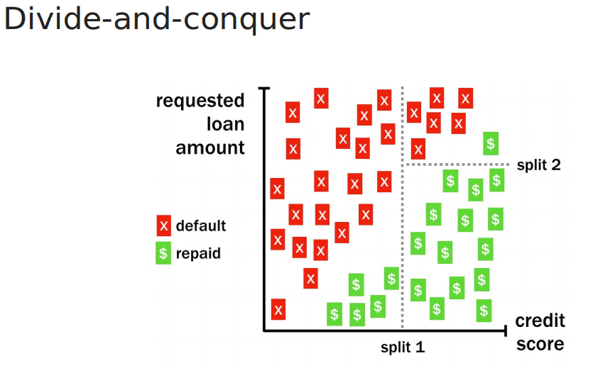

Slide 14
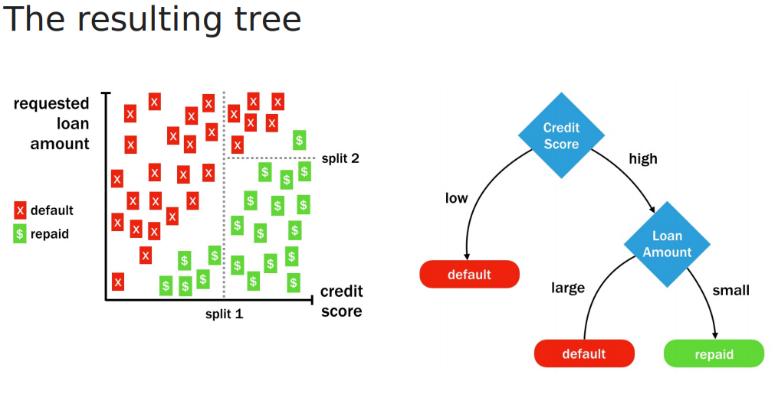

Slide 15
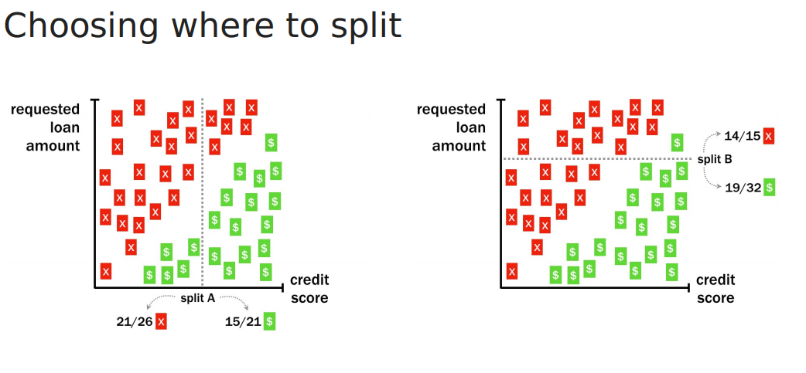

Slide 16
Measure for Selecting the best Split
Entropy
Gini
Classification error

Slide 17
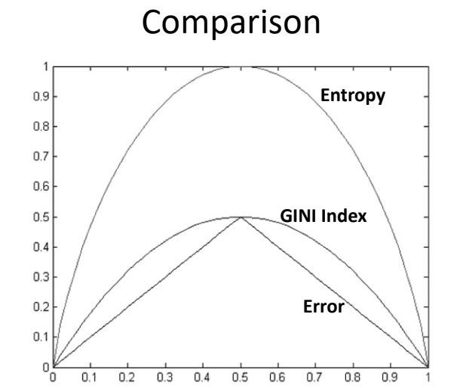

Slide 18
Gini Index
Gini index says, if we select two items from a population at random then they must be of same class and probability for this is 1 if population is pure.
It works with categorical target variable “Success” or “Failure”.
It performs only Binary splits
Higher the value of Gini higher the homogeneity.
CART (Classification and Regression Tree) uses Gini method to create binary splits.

Slide 19
Steps to Calculate Gini for a split
Calculate Gini for sub-nodes, using formula sum of square of probability for success and failure (p^2+q^2).
Calculate Gini for split using weighted Gini score of each node of that split

Slide 20
Example
Referring to example used above, where we want to segregate the students based on target variable ( playing cricket or not ). In the snapshot below, we split the population using two input variables Gender and Class. Now, I want to identify which split is producing more homogeneous sub-nodes using Gini index.

Slide 21
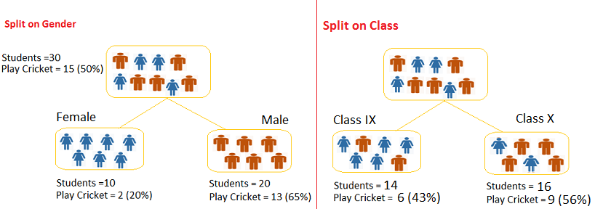
Example
Split on Gender:
Calculate, Gini for sub-node Female = (0.2)*(0.2)+(0.8)*(0.8)=0.68
Gini for sub-node Male = (0.65)*(0.65)+(0.35)*(0.35)=0.55
Calculate weighted Gini for Split Gender = (10/30)*0.68+(20/30)*0.55 = 0.59
Similar for Split on Class:
Gini for sub-node Class IX = (0.43)*(0.43)+(0.57)*(0.57)=0.51
Gini for sub-node Class X = (0.56)*(0.56)+(0.44)*(0.44)=0.51
Calculate weighted Gini for Split Class = (14/30)*0.51+(16/30)*0.51 = 0.51
**you can see that Gini score for Split on Gender is higher than Split on Class, hence, the node
split will take place on Gender.

Slide 22
Entropy
Entropy can be calculated using formula:-
Here p and q is probability of success and failure respectively in that node. Entropy is also used with categorical target variable.
It chooses the split which has lowest entropy compared to parent node and other splits. The lesser the entropy, the better it is.

Slide 23
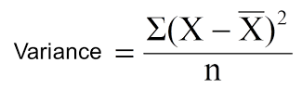
Reduction in Variance
Reduction in variance is an algorithm used for continuous target variables (regression problems). This algorithm uses the standard formula of variance to choose the best split.
The split with lower variance is selected as the criteria to split the population:
Above X-bar is mean of the values, X is actual and n is number of values.

Slide 24
Steps to calculate Variance:
Calculate variance for each node.
Calculate variance for each split as weighted average of each node variance.

Slide 25
Example
Let’s assign numerical value 1 for play cricket and 0 for not playing cricket. Now follow the steps to identify the right split:
Variance for Root node, here mean value is (15*1 + 15*0)/30 = 0.5 and we have 15 one and 15 zero. Now variance would be ((1-0.5)^2+(1-0.5)^2+….15 times+(0-0.5)^2+(0-0.5)^2+…15 times) / 30, this can be written as (15*(1-0.5)^2+15*(0-0.5)^2) / 30 = 0.25
Mean of Female node = (2*1+8*0)/10=0.2 and Variance = (2*(1-0.2)^2+8*(0-0.2)^2) / 10 = 0.16
Mean of Male Node = (13*1+7*0)/20=0.65 and Variance = (13*(1-0.65)^2+7*(0-0.65)^2) / 20 = 0.23
Variance for Split Gender = Weighted Variance of Sub-nodes = (10/30)*0.16 + (20/30) *0.23 = 0.21

Slide 26
Example
Mean of Class IX node = (6*1+8*0)/14=0.43 and Variance = (6*(1-0.43)^2+8*(0-0.43)^2) / 14= 0.24
Mean of Class X node = (9*1+7*0)/16=0.56 and Variance = (9*(1-0.56)^2+7*(0-0.56)^2) / 16 = 0.25
Variance for Split Class = (14/30)*0.24 + (16/30) *0.25 = 0.25
You can see that Gender split has lower variance compare to parent node, so the split would take place on Gender variable.

Slide 27
Over-fitting in decision trees
Over-fitting is one of the key challenges faced while modeling decision trees.
If there is no limit set of a decision tree, it will give you 100% accuracy on training set because in the worse case it will end up making 1 leaf for each observation.
Thus, preventing overfitting is pivotal while modeling a decision tree and it can be done using Tree pruning

Slide 28
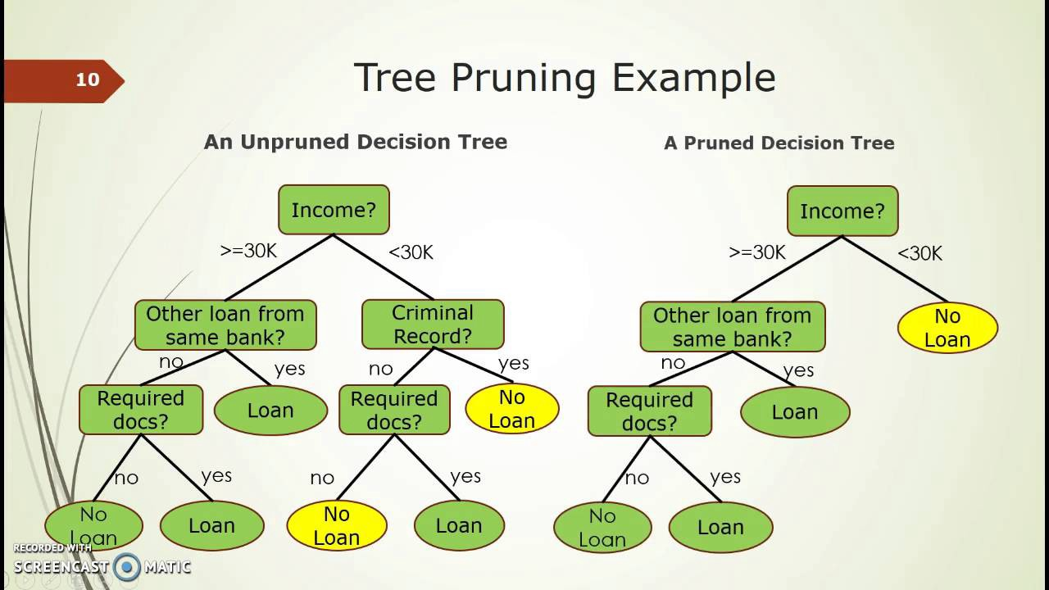

Slide 29
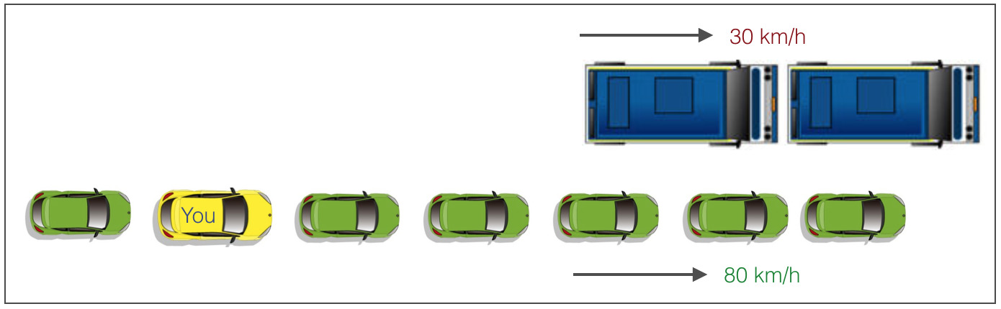
Tree Pruning
As discussed earlier, the technique of setting constraint is a greedy-approach.
In other words, it will check for the best split instantaneously and move forward until one of the specified stopping condition is reached. Let’s consider the following case when you’re driving:

Slide 30
Example
There are 2 lanes:
A lane with cars moving at 80km/h
A lane with trucks moving at 30km/h
At this instant, you are the yellow car and you have 2 choices:
Take a left and overtake the other 2 cars quickly
Keep moving in the present lane
Lets analyze these choice. In the former choice, you’ll immediately overtake the car ahead and reach behind the truck and start moving at 30 km/h, looking for an opportunity to move back right. All cars originally behind you move ahead in the meanwhile. This would be the optimum choice if your objective is to maximize the distance covered in next say 10 seconds.
In the later choice, you sale through at same speed, cross trucks and then overtake maybe depending on situation ahead. Greedy you!

Slide 31
Example
This is exactly the difference between normal decision tree & pruning. A decision tree with constraints won’t see the truck ahead and adopt a greedy approach by taking a left.
On the other hand if we use pruning, we in effect look at a few steps ahead and make a choice.

Slide 32

Pruning
So we know pruning is better. But how to implement it in decision tree? The idea is simple.
We first make the decision tree to a large depth.
Then we start at the bottom and start removing leaves which are giving us negative returns when compared from the top.
Suppose a split is giving us a gain of say -10 (loss of 10) and then the next split on that gives us a gain of 20. A simple decision tree will stop at step 1 but in pruning, we will see that the overall gain is +10 and keep both leaves.

Slide 33
Pruning helps us to avoid overfitting
Generally it is preferred to have a simple model, it avoids overfitting issue.
Any additional split that does not add significant value is not worth while.
We can avoid overfitting by changing the parameters like max_leaf_nodes min_samples_leaf max_depth
Pruning Parameters max_leaf_nodes Reduce the number of leaf nodes min_samples_leaf Restrict the size of sample leaf
Minimum sample size in terminal nodes can be fixed to 30, 100, 300 or 5% of total max_depth
Reduce the depth of the tree to build a generalized tree Set the depth of the tree to 3, 5, 10 depending after verification on test data

Slide 34
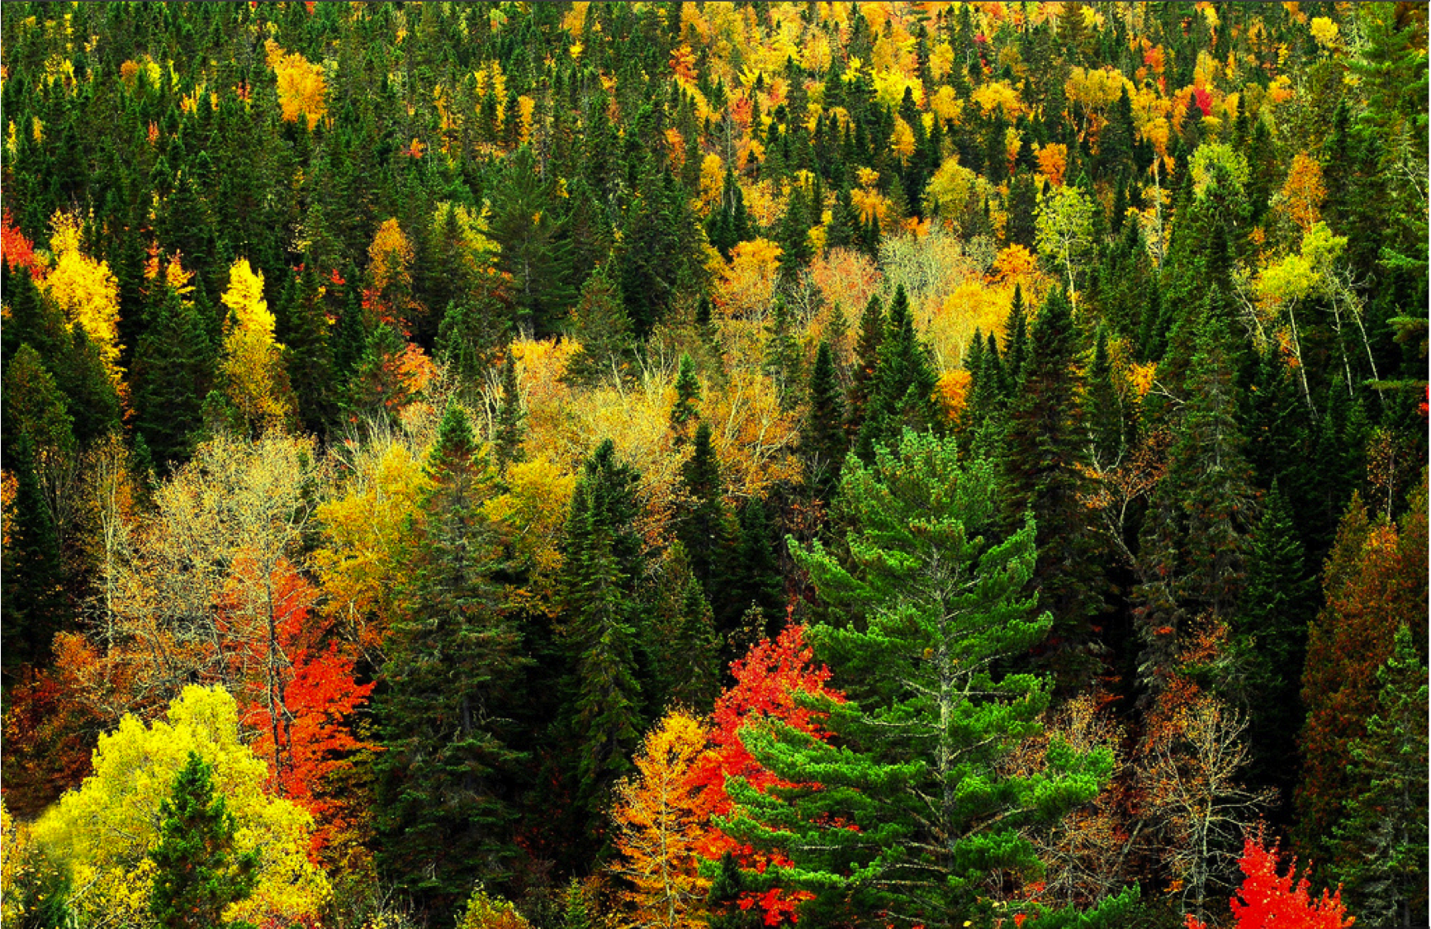
What is Random Forest ? How does it work?

Slide 35
Random Forest
Random Forest is considered to be a panacea of all data science problems. On a funny note, when you can’t think of any algorithm (irrespective of situation), use random forest!
Random Forest is a versatile machine learning method capable of performing both regression and classification tasks.
It also undertakes dimensional reduction methods, treats missing values, outlier values and other essential steps of data exploration, and does a fairly good job.
It is a type of ensemble learning method, where a group of weak models combine to form a powerful model.

Slide 36
How does it work?
In Random Forest, we grow multiple trees as opposed to a single tree
To classify a new object based on attributes, each tree gives a classification and we say the tree “votes” for that class.
The forest chooses the classification having the most votes (over all the trees in the forest) and in case of regression, it takes the average of outputs by different trees.

Slide 37
Steps of RF
It works in the following manner. Each tree is planted & grown as follows:
Assume number of cases in the training set is N. Then, sample of these N cases is taken at random but with replacement. This sample will be the training set for growing the tree.
If there are M input variables, a number m<M is specified such that at each node, m variables are selected at random out of the M. The best split on these m is used to split the node. The value of m is held constant while we grow the forest.
Each tree is grown to the largest extent possible and there is no pruning.
Predict new data by aggregating the predictions of the ntree trees (i.e., majority votes for classification, average for regression).

Slide 38
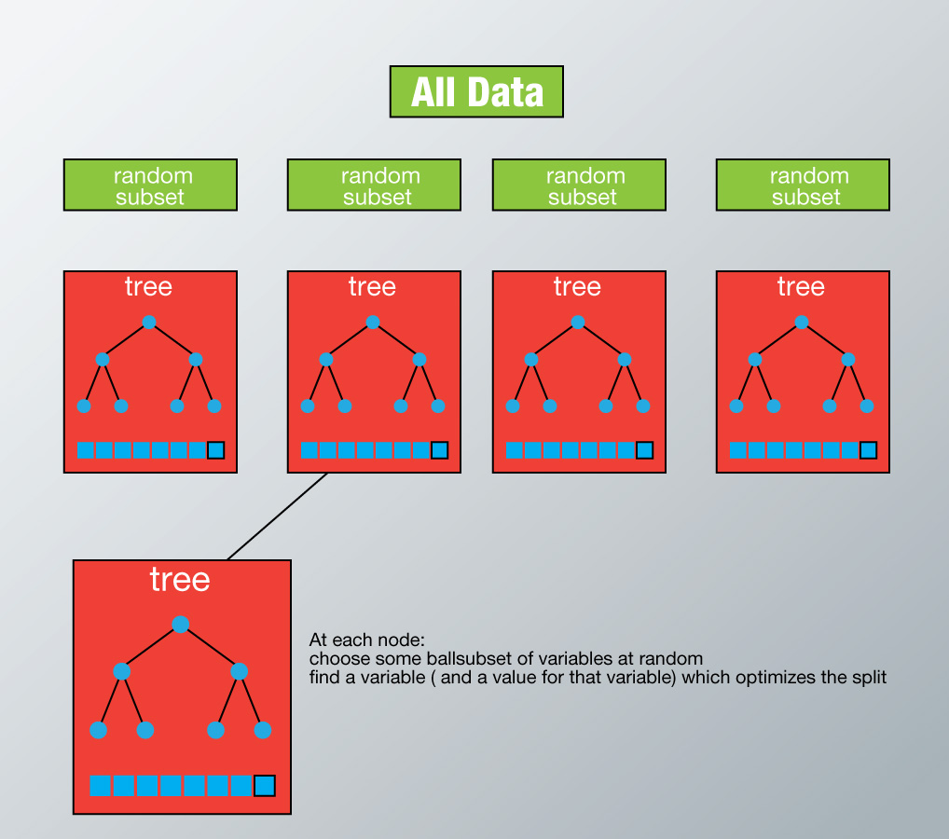

Slide 39
Random Forest VS Bagging Trees
The fundamental difference is that in Random forests, only a subset of features are selected at random out of the total and the best split feature from the subset is used to split each node in a tree, unlike in bagging where all features are considered for splitting a node.
Random Forests improve variance by reducing correlation between trees, this is accomplished by random selection of feature-subset for split at each node. While Bagging improves variance by averaging/majority selection of outcome from multiple fully grown trees on variants of training set.

Slide 40
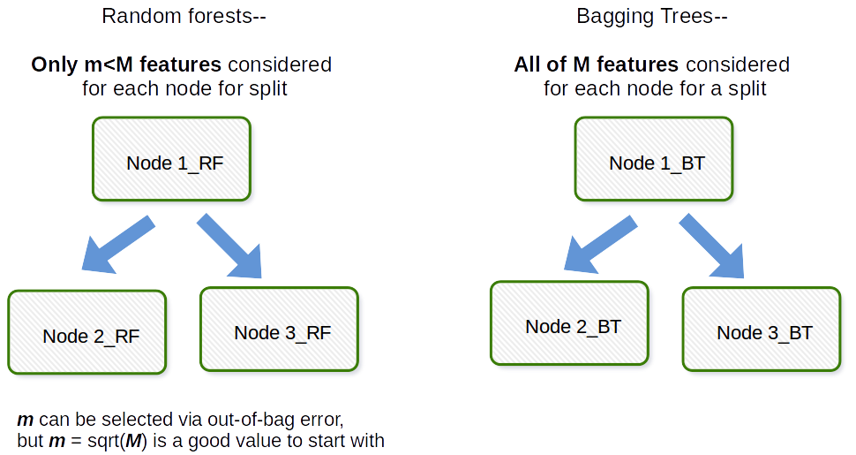
Random Forest VS Bagging Trees

Slide 41
Random Forests / Ensemble Trees
RF can handle thousands of input variables and identify most significant variables so it is considered as one of the dimensionality reduction methods.
One approach to dimensionality reduction is to generate a large and carefully constructed set of trees against a target attribute and then use each attribute’s usage statistics to find the most informative subset of features.
Specifically, we can generate a large set (2000) of very shallow trees (2 levels), with each tree being trained on a small fraction (3) of the total number of attributes.
If an attribute is often selected as best split, it is most likely an informative feature to retain.
A score calculated on the attribute usage statistics in the random forest tells us ‒ relative to the other attributes ‒ which are the most predictive attributes.

Slide 42
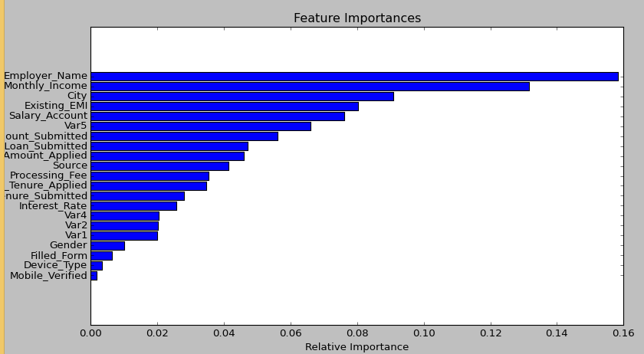
Importance of variable
Importance of variable, which can be a very handy feature (on some random data set).

